Slide 1
MISQ round 2 revision
Dylan Junluo CHEN
Supervisor: Ben LIU & Xin LI

Slide 2


Background
Online Q&A Communities
Supply
Internal GenAI
Supply
Supply
Questions
Answers
Questioners
Answerers
Our Research Question:
How does internal GenAI affect human answerers (supply) and viewers (recognition) in online Q&A communities?
External GenAI
(e.g., ChatGPT)

Slide 3
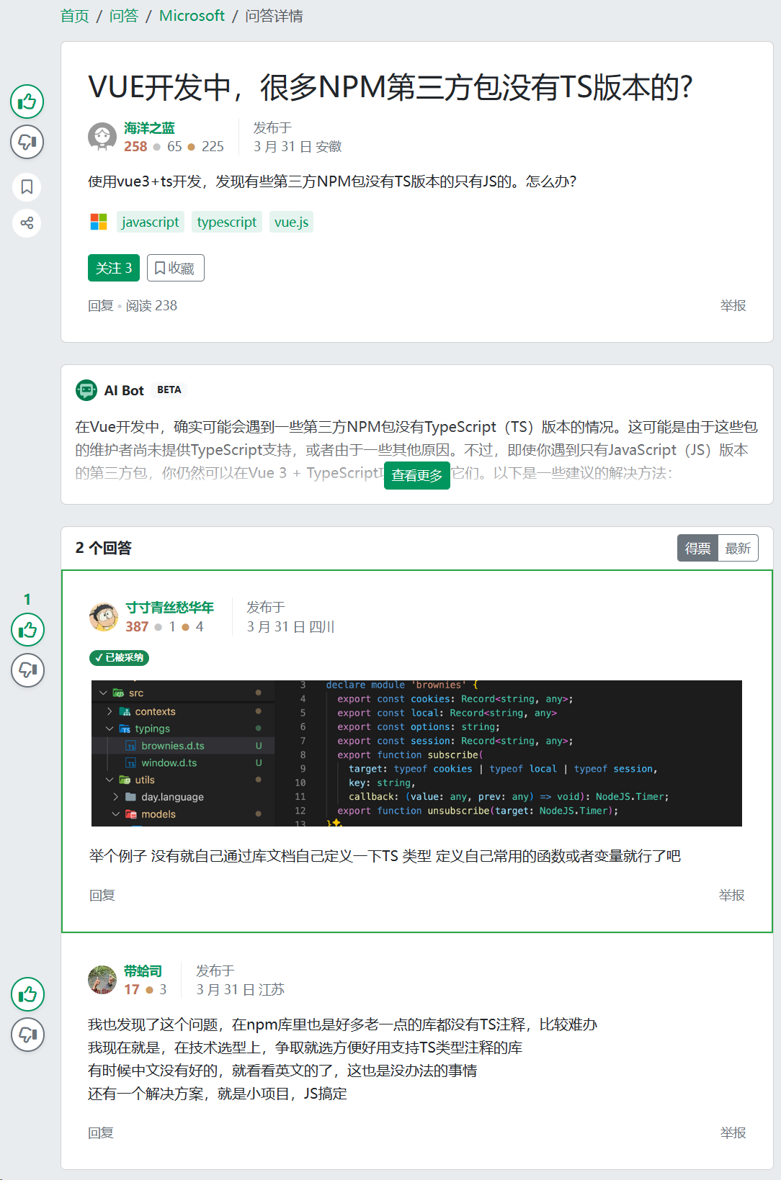
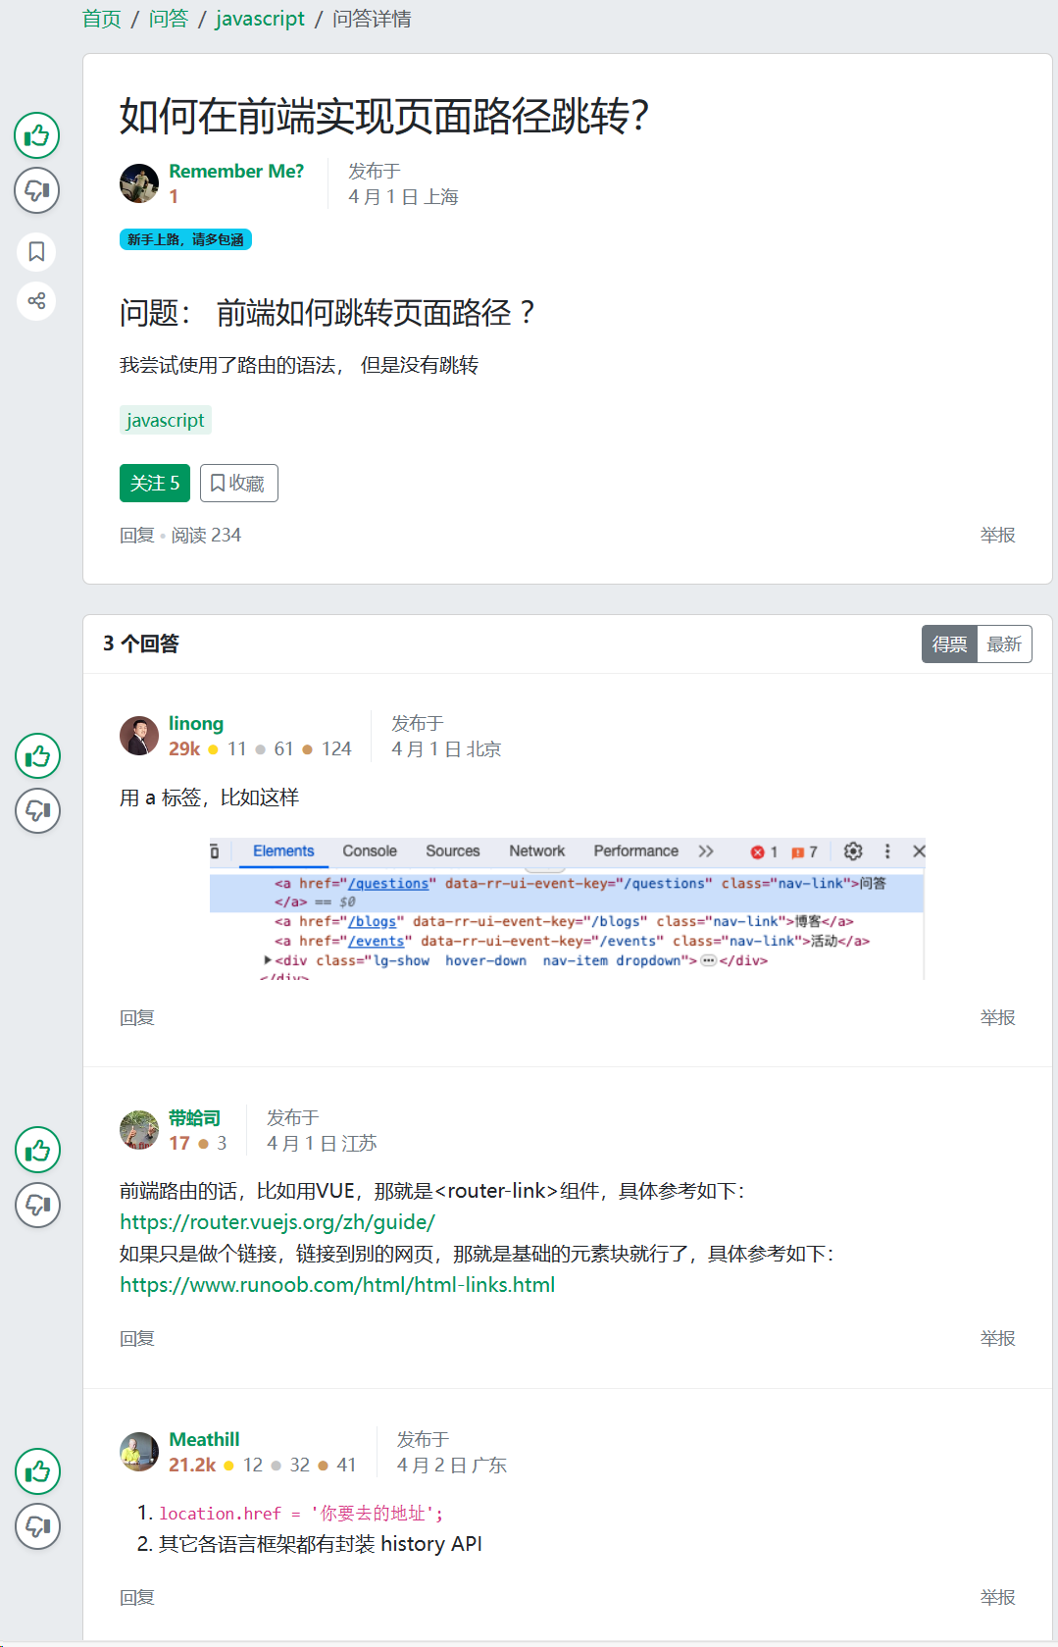
A Randomized Field Experiment on SegmentFault
AI group (treatment group)
no AI group (control group)

Slide 4
Our original results and framework
Quality Degradation
Attention Diversion
Elevated Expectations
(-)
Viewer Recognition
Has AI Answer
(-)
Answer Participation
Source Effect
Content Effect
Position Effect

Slide 5
Our original results and framework
Quality Degradation
Attention Diversion
Elevated Expectations
Viewer Recognition
Has AI Answer
Answer Participation
Source Effect
Content Effect
Position Effect

Slide 6
260608 meeting version
Our new framework
Has AI Answer
Answer Participation
Has AI Answer
Answer Innovation
AI Answer Length
AI Answer Quality
Prior Answer Length
Prior Answer Quality
Fast
Slow
Dual Processing

Slide 7
260608 after meeting Ben make adjustments
Our new framework
Answer Quality
Has AI Answer
Answer Participation
AI Answer Length
AI Answer Quality
Fast Processing
Slow Processing

Slide 8
Theoretical Development: Competition with a "Weaker" Competitor
Core Logic:
Humans view AI as a weaker competitor (without seeing content),
yet AI content triggers strong competitive dynamics that deter human contributions and elevate human answer quality.
DV: | Contribution (Fast) | Answer Quality (Slow)
AI Presence (as a weaker competitor) | H1: ↑ (easy win → motivates entry) | H3: ↓ (weak rival → complacency)
Moderated by Length | H2: attenuates H1 (occupied space → deters entry) | —
Moderated by Quality | — | H4: reverses H3 (credible rival → raises the bar)
Detailed theoretical development, see next slide

Slide 9
Competition Effect on Contribution (Fast Processing — Length as Signal)
Has AI Answer
Answer Participation
AI Answer Length
Fast Processing
H1: AI presence increases human contribution.
Humans perceive AI as a “weak” competitor (because of competitive arousal – experts believe SegementFault is their expert-specific area)
Regardless of AI answer length or quality, the competitive trigger stimulates a baseline impulse to respond.
H2: The competitive crowding-out is stronger when the AI answer is longer.
Length is a fast-processed heuristic for how “comprehensive" the competitive space is.
A longer AI answer signals a more formidable competitive barrier → the "easy win" perception erodes → the baseline positive contribution effect is attenuated or reversed.

Slide 10
Competition Effect on Answer Quality (Slow Processing — Quality as Benchmark)
Has AI Answer
Answer Quality
AI Answer Quality
Slow Processing
H3: AI presence decreases human answer quality.
Facing a perceived weaker competitor, humans become complacent → reduced effort investment → "I don't need to try hard to beat this" → lower quality.
Regardless of AI answer length or quality, the baseline competitive posture toward a "weak" rival lowers the quality bar humans set for themselves.
H4: The negative quality effect reverses when AI answer quality is high.
High AI quality can only be assessed through slow, deliberate processing → once recognized, it shatters the "weak competitor" assumption.
A high-quality AI answer serves as a visible benchmark to surpass → triggers genuine competitive effort → humans invest more to demonstrate superiority → quality rises.
"The AI is actually good — I must prove I'm better."

Slide 11
Our new main results
Human consider AI as a weaker competitor.
But AI outcome triggers a strong sense of competition
 | (1) | (2) | (3) | (4)
DV: | log of the number of human answers provided within 7 days (answerNumi) |  | first human answer quality (human1SimWithLLMi)
AI_{i} | -0.046 *** | 0.226 ** | 0.000 | -0.120 .
 | (0.011) | (0.085) | (0.007) | (0.067)
AI_{i} * AILength_{i} |  | -0.045 ** |  | -0.013
 |  | (0.014) |  | (0.011)
AI_{i} * AISimWithLLM_{i} |  | -0.038 |  | 0.350 ***
 |  | (0.051) |  | (0.034)
question controls | √ | √ | √ | √
questioner controls | √ | √ | √ | √
question timing FE | √ | √ | √ | √
N | 3,613 | 3,603 | 2,685 | 2,685

Slide 12
Our new main results (interaction plot)
AI deter human contribution when answer is lengthy
AI elevate human answer quality when answer is high-quality

Slide 13
Appendix

Slide 14
Robustness
To fill

Slide 15
Broader Platform Engagement: Effects of AI-Generated Answers on Questioner Activity and Question Visibility
 | (1) | (2) | (3) | (4) | (5)
DV: | the logarithm of the number of questioner’s subsequent activities after receiving an answer in |  |  | DV: the logarithm of the number of comments the questioner posted in response to answers received by question i (Comment_{i}) | DV: the logarithm of the cumulative viewership count for question i (View_{i})
 | 1 month | 2 months | 3 months
AI_{i} | -0.010 | -0.002 | -0.009 | -0.039 | -0.009
 | (0.027) | (0.030) | (0.030) | (0.020) | (0.016)
question timing FE | √ | √ | √ | √ | √
other controls | √ | √ | √ | √ | √
N | 3,613 | 3,613 | 3,613 | 2,748 | 3,613

